Slide 1
CS 2520: Wide Area Networks (and Internet Services)
Lecture 2: Transport Layer Introduction, Reliable Transport Principles
Dr. Amy Babay, Fall 2021

Slide 2

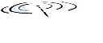




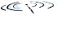






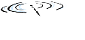


Transport Layer Intro
Provides logical communication between application processes
Abstracts out network details; applications can act as if directly connected
Built on top of network layer service
Provides best-effort (unreliable) communication between hosts
Different transport protocols can offer different services
On the Internet: UDP vs TCP
application
transport
network
data link
physical
mobile network
national or global ISP
logical end-end transport
local or regional ISP
home network
content
provider
network
application
transport
network
data link
physical
datacenter
network
enterprise
network

Slide 3

Quick aside: What exactly is a network application?
Two or more processes running in end systems that send messages over a network to accomplish some goal
Each process is a running instance of a program
Programs can be written in any programming language (C, Java, Python, Go, etc.)
Programs use the socket API (Application Programming Interface) to send and receive messages
application
socket
application
controlled by
app developer
process
process
transport
transport
network
network
controlled
by OS
link
Internet
link
physical
physical

Slide 4
What is a socket?
Interface between the application layer and the transport layer
At a high level (we’ll try this out next week):
Program opens a socket, specifying which transport layer service it wants to use
Can use send and receive functions on that socket
Closes socket to release resources
application
socket
application
controlled by
app developer
From a programming perspective, similar to APIs for file I/O
process
process
transport
transport
network
network
controlled
by OS
link
Internet
link
physical
physical

Slide 5
How do we identify sockets?
A socket is identified by:
IP address: 32-bit number (in IPv4) that uniquely identifies the host
e.g. 136.142.227.11 = hydrogen.cs.pitt.edu, one of the machines in the CS elements cluster
2291065611 = 10001000100011101110001100001011 = 136.142.227.11
Port: 16-bit number (between 0 and 65535) that identifies this socket (vs all other network applications running on this host)
Service: transport layer protocol (TCP vs UDP)
Compared to file I/O,
IP address + port ~= filename
application
socket
application
controlled by
app developer
process
process
transport
transport
network
network
controlled
by OS
link
Internet
link
physical
physical

Slide 6
What transport services can we use?
UDP (User Datagram Protocol)
Best-effort (unreliable) data transfer
Sender can inject messages at whatever rate they choose, and UDP will pass them to the network layer. But it does not provide delivery guarantees (no recovery of lost packets)
TCP (Transmission Control Protocol)
Connection-oriented reliable, in-order data transfer
Guarantees that sent data is received (unless connection breaks)
Flow control to avoid overwhelming receiver
Congestion control to throttle sending when network is overloaded

Slide 7
What transport services can we use?
you
https://dev.to/ben/explain-tcp-like-im-five

Slide 8
Transport Layer Services
Core service: Multiplexing/Demultiplexing
Provide process-to-process communication on top of network layer’s host-to-host communication
Map incoming packets to the correct socket based on IP and port numbers
Error detection
Calculate checksum over packet contents to check for corruption
TCP additionally offers:
Reliable data transfer
Flow control
Congestion control

Slide 9
UDP Header Structure – metadata for core services
32 bits
source port #
dest port #
length
checksum
application
data
(payload)
length, in bytes of UDP segment, including header
data to/from application layer
UDP segment format

Slide 10
Today: focus on reliability
Many applications need completely reliable data transfer
File transfer, remote log in, email, web browsing …
Given that the network layer only provides a best-effort service, how can we implement a reliable transport service on top of it?

Slide 11
Network Model
What do we mean when we say the network is unreliable?
Packets can be:
Dropped (lost)
Corrupted
Delayed
Re-ordered
Duplicated

Slide 12
ARQ Protocols: Automatic Repeat reQuest
What can we do about it?
When a packet is dropped or corrupted, it needs to be retransmitted (repeated)
How does a sender know that it needs to retransmit?
Feedback from the receiver: acknowledgments (ACKs) that say what was received so far, or negative acknowledgments (NACKs) that say what has been missed
Lack of feedback (timeout): if the sender doesn’t receive an acknowledgment after waiting “long enough” it can decide the packet was lost
How to identify duplicates/reordering?
Sequence numbers
Classic reliable ARQ protocols:
Stop-and-wait
Go-Back-N
Selective Repeat

Slide 13
Stop-and-Wait
Stop-and-wait: sender sends one packet, then waits for ACK from receiver
If ACK is received, move on and send next packet
If no ACK received before timeout, assume packet was lost and resend it

Slide 14
Stop-and-Wait
send pkt 0
☑
ack
send pkt 1
☒
timeout
re-send pkt 1
ack
send pkt 2
Sender
Receiver

Slide 15
Stop-and-Wait
send pkt 0
☑
timeout
ack
☒
re-send pkt 0
discard duplicate pkt 0
ack
send pkt 1
ack
send pkt 2
Sender
Receiver

Slide 16
Stop-and-Wait
send pkt 0
☑
timeout
ack 0
re-send pkt 0
discard duplicate pkt 0
send pkt 1
ack 0
discard duplicate ACK 0
ack 1
send pkt 2
Sender
Receiver

Slide 17
Analyzing Stop-and-Wait Performance
Stop-and-Wait is a correct protocol…but is it good?
What does “good” mean here? (consider a file transfer application)
Low total transfer time (measured in seconds)
High transfer rate, or throughput (measured in bits/second)

Slide 18
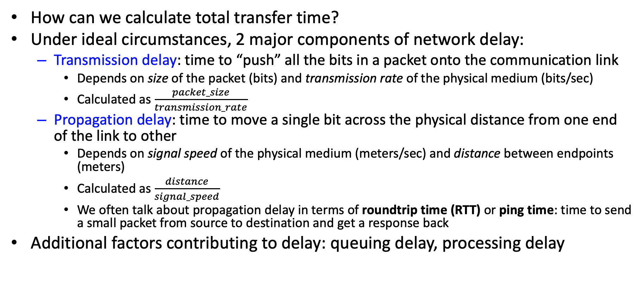
Analyzing Stop-and-Wait
How can we calculate total transfer time?
Under ideal circumstances, 2 major components of network delay:
Transmission delay: time to “push” all the bits in a packet onto the communication link
Depends on size of the packet (bits) and transmission rate of the physical medium (bits/sec)
Calculated as $\frac{packet_size}{transmission_rate}$
Propagation delay: time to move a single bit across the physical distance from one end of the link to other
Depends on signal speed of the physical medium (meters/sec) and distance between endpoints (meters)
Calculated as $\frac{distance}{signal_speed}$
We often talk about propagation delay in terms of roundtrip time (RTT) or ping time: time to send a small packet from source to destination and get a response back
Additional factors contributing to delay: queuing delay, processing delay

Slide 19
Analyzing Stop-and-Wait
How can we calculate total transfer time?
sender
receiver
first packet bit transmitted, t = 0
first packet bit arrives
RTT
last packet bit arrives, send ACK
ACK arrives, send next packet,
t = RTT + packet_size / transmission_rate
(assumes 0 transmission delay for ACK)

Slide 20
Analyzing Stop-and-Wait
First, consider LAN environment
RTT ~0.1 millisecond
Bandwidth ~1Gbps
Packet size ~1500bytes
Transmission delay: (1500 bytes * 8 bits/byte)/(10^9 bits/sec) = 12 microsec = 0.012 ms
Propagation delay (RTT): 0.1ms
Total Time to send one packet and get ack: 0.012ms + 0.1ms = 0.112 ms
Consider 1 GB file: 10^9 bytes / (1500 bytes) ~= 666667 packets
0.112 ms / packet * 666667 packets ~= 74667 ms = 74.667 sec transfer time
(10^9 bytes * 8 bits/byte) / 74.667 sec ~= 107,142,378 bits/sec ~= 107 Mbps transfer rate

Slide 21
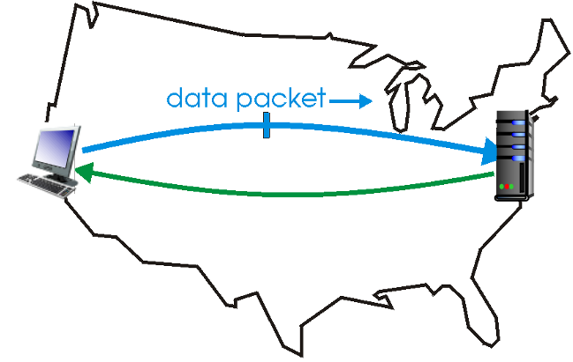
Analyzing Stop-and-Wait
Now, consider WAN environment
RTT ~60 milliseconds
Bandwidth ~1Gbps
Packet size ~1500bytes
Transmission delay: (1500 bytes * 8 bits/byte)/(10^9 bits/sec) = 12 microsec = 0.012 ms
Propagation delay (RTT): 60ms
Total Time to send one packet and get ack: 0.012ms + 0.1ms = 60.012 ms
Consider 1 GB file: 10^9 bytes / (1500 bytes) ~= 666667 packets
60.012 ms / packet * 666667 packets ~= 40008020 ms ~= 40,008 sec ~= 11 hours transfer time
(10^9 bytes * 8 bits/byte) / 40,008 sec ~= 199,960 bits/sec ~= 200 kbps transfer rate

Slide 22
Stop-and-Wait
Pros:
Simple
Requires minimal memory – sender just keeps last packet
Cons:
SLOW – only 1 packet can be sent per roundtrip time

Slide 23
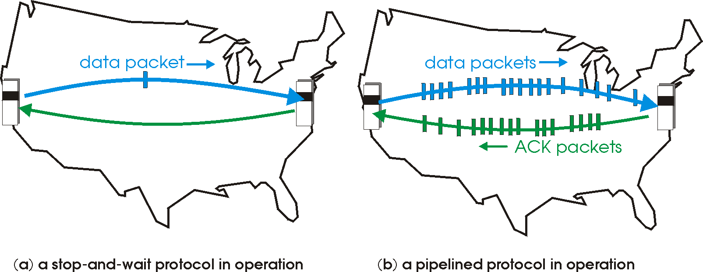
Improving Performance
How can we improve our protocol to get better performance?
Pipelining – instead of stopping and waiting after every packet, we can send multiple packets to “fill the pipe” before waiting for acknowledgment

Slide 24
Pipelined Reliable Data Transfer
Instead of only 1 unacknowledged packet, sender can have up to N unacknowledged packets at a time
N packets “in-flight”
Sender needs to buffer sent but not-yet-acknowledged packets so they can be retransmitted as needed
Sender buffer typically operates as a “sliding window”
base
N
Sent and ACK’d
Sent but not ACK’d
sequence number →
Not yet sent
next_seq

Slide 25
Sliding Window
Sender buffer typically operates as a “sliding window”
base is the sequence number of the start of window (last ACK’d packet + 1)
next_seq is the sequence number that will be used for the next packet to send
base
N
Sent and ACK’d
Sent but not ACK’d
sequence number →
Not yet sent
next_seq

Slide 26
A Pipelined Reliable Data Transfer Protocol: “Go-Back-N”
Go-Back-N protocol key ideas:
Sender can have up to N unacknowledged packets “in-flight” at a time
Receiver sends cumulative acknowledgments
Cumulative acknowledgement for sequence number X means I have received everything up to and including sequence number X
sometimes called ARU for “all received up-to”
Acknowledgments let the sender “slide its window forward” and send new packets until there are again N unacknowledged packets
When a timeout occurs, the sender will “Go-Back-N” and resend ALL not-yet-acknowledged packets (of which there can be up to N)

Slide 27
Go-Back-N Normal Case Operation
Sender Window
Window size = 3 packets
Receiver
{1, x, x}
1
{1, 2, x}
2
{1, 2, 3}
3
deliver 1, ack 1
deliver 2, ack 2
{2, 3, 4}
4
deliver 3, ack 3
{3, 4, 5}
5
.
.
.
{4, 5, 6}
6
deliver 4, ack 4
.
.
.
deliver 5, ack 5
deliver 6, ack 6
Sender
Receiver
Time

Slide 28
Go-Back-N Operation with Loss
Sender Window
Window size = 3 packets
Receiver
{1, x, x}
1
{1, 2, x}
2
{1, 2, 3}
3
deliver 1, ack 1
deliver 2, ack 2
{2, 3, 4}
4
deliver 3, ack 3
{3, 4, 5}
5
X packet 4 is lost
{4, 5, 6}
6
.
.
.
??
??
Sender
Receiver
Time

Slide 29
Go-Back-N Operation with Loss
Sender Window
Window size = 3 packets
Receiver
{1, x, x}
1
{1, 2, x}
2
{1, 2, 3}
3
deliver 1, ack 1
deliver 2, ack 2
{2, 3, 4}
4
deliver 3, ack 3
{3, 4, 5}
5
X packet 4 is lost
Timeout
Packet 4
{4, 5, 6}
6
.
.
.
Discard, resend ack 3
4
Discard, resend ack 3
5
6
Sender
Receiver
Time

Slide 30
Go-Back-N: Details
Sender
Sends up to N unacknowledged packets
Maintains timer for oldest unacknowledged packet
Set timer when sending first packet in empty window
Reset timer when receiving ack that moves up window (or stop if no more un-ack’d packets)
(and reset timer after resending window)
Resends ALL un-ack’d packets on timeout
Receiver
Sends cumulative ACK upon receiving next expected packet
Resends last cumulative ACK upon receiving out-of-order packet
Discards packets received out of order (some variants allow these to be buffered – why?)

Slide 31
Go-Back-N
Pros:
Fairly Simple
Requires limited memory – sender keeps window, receiver just 1 packet
Allows good performance (with appropriate choice of window size) when loss is rare
Cons:
Retransmits full window on loss (wastes bandwidth by retransmitting packets unnecessarily)

Slide 32
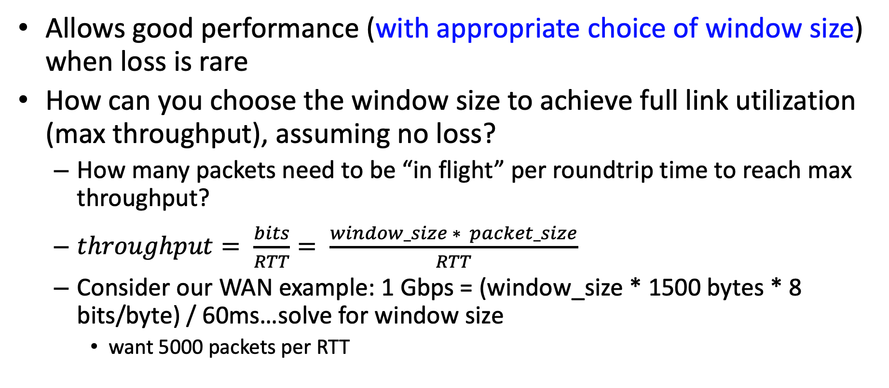
Go-Back-N
Allows good performance (with appropriate choice of window size) when loss is rare
How can you choose the window size to achieve full link utilization (max throughput), assuming no loss?
How many packets need to be “in flight” per roundtrip time to reach max throughput?
$throughput= \frac{bits}{RTT}= \frac{window_size ∗ packet_size}{RTT}$
Consider our WAN example: 1 Gbps = (window_size * 1500 bytes * 8 bits/byte) / 60ms…solve for window size
want 5000 packets per RTT

Slide 33
Another Approach: “Selective Repeat”
Sender can send up to N unacknowledged packets
Receiver individually acknowledges each correctly received packet and buffers out-of-order packets
Sender maintains separate timer for each un-ACK’d packet to retransmit individually (i.e. repeat selectively)

Slide 34
Another Approach: “Selective Repeat”
Sender can send up to N unacknowledged packets
Receiver individually acknowledges each correctly received packet and buffers out-of-order packets
Sender maintains separate timer for each un-ACK’d packet to retransmit individually (i.e. repeat selectively)
base
N
Sent and ACK’d
Sent but not ACK’d
sequence number →
Not yet sent
next_seq

Slide 35
Another Approach: “Selective Repeat”
Sender buffer:
sendbase
N
Sent and ACK’d
Sent but not ACK’d
sequence number →
Not yet sent
next_seq
Receiver buffer:
recvbase
N
Received and ACK’d
Not received (but expected)
sequence number →
Not received

Slide 36
Another Approach: “Selective Repeat”
Sender buffer:
sendbase
N
Sent and ACK’d
Sent but not ACK’d
sequence number →
Not yet sent, not usable seq (outside window)
next_seq
Not yet sent, usable seq (in window)
Receiver buffer:
recvbase
N
Received and ACK’d
Not received (but expected)
sequence number →
Not received, outside window
Not received, able to accept (in window)

Slide 37
Selective Repeat Operation with Loss
Sender Window
Window size = 3 packets
Receiver
{1, x, x}
1
{1, 2, x}
2
{1, 2, 3}
3
deliver 1, ack 1
deliver 2, ack 2
{2, 3, 4}
4
deliver 3, ack 3
{3, 4, 5}
5
X packet 4 is lost
{4, 5, 6}
6
.
.
.
??
??
Sender
Receiver
Time

Slide 38
Selective Repeat Operation with Loss
Sender Window
Window size = 3 packets
Receiver
{1, x, x}
1
{1, 2, x}
2
{1, 2, 3}
3
deliver 1, ack 1
deliver 2, ack 2
{2, 3, 4}
4
deliver 3, ack 3
{3, 4, 5}
5
X packet 4 is lost
Timeout
Packet 4
{4, 5, 6}
6
buffer 5, ack 5
4
buffer 6, ack 6
{4, 5, 6}
{4, 5, 6}
deliver 4,5,6 ack 4
{7, x, x}
7
Sender
Time
Receiver

Slide 39
Selective Repeat
Pros:
Requires limited memory – sender and receiver each keep one window
Allows good performance (with appropriate choice of window size)
More bandwidth-efficient than Go-Back-N
Cons:
Slightly more complex (need to maintain multiple timers)
Can we improve efficiency further?

Slide 40
A Selective Repeat Variant (Project 1)
Basic selective repeat may still retransmit packets unnecessarily if ACKs are lost…
Another approach is for the receiver to explicitly request missed packets
Combine cumulative ACKs and NACKs
ACK indicates all messages up to and including ACK’d sequence number have been received (ARU – All Received Up-to)
When receiver detects a gap in the sequence numbers, it requests the missing packet(s)
In project 1, you’ll design and implement a protocol like this!

Slide 41
Reliable Data Transfer: What happens on the Internet?
TCP uses a combination of the techniques we’ve seen here:
Cumulative acknowledgments (like Go-back-N)
Does NOT resend full window on timeout
Traditional: resend only oldest unacknowledged packet
SACK: use selective acknowledgments to indicate what has been received beyond the cumulative ack
with a few differences:
Window is measured in bytes, rather than discrete packets
Timeouts are calculated dynamically based on estimated roundtrip time
Fast retransmit optimization: sender uses duplicate acknowledgments as evidence of loss (retransmit before timeout expires)

Slide 42
Another view…
Are there any drawbacks to requiring completely reliable, in-order packet delivery?
Any types of applications this might cause problems for?

Slide 43
Challenges for a completely reliable, ordered service
What happens when a packet is lost?
All following packets are blocked from being delivered until that packet is recovered (head of line blocking)
Good fit for certain applications (e.g. file transfer, remote login)
When might this be a problem?
When applications have real-time constraints and would prefer to drop the packet (e.g. interactive video, audio, gaming)
When the application doesn’t need a single total order on all packets
e.g. Web browsing: each webpage typically consists of multiple distinct files (base html file, images, embedded videos other elements)

Slide 44
Questions?

